Slide 1
Professional Practices in IT (HSS-301)
Lecture 1

Slide 2
Course Information
Course Code:
HSS-301
Course Name
Professional Practices in IT
Course Objective:
The objective of the course is to make students aware of their professional responsibilities when they will work in IT sector. The course will teach students about the historical, social, ethical, economical and professional issues related to IT profession.

Slide 3
Marks Distribution
Assignments ……………….. 10%
Quizzes ………………………… 10%
Presentation………………… 15%
Class Participation.………. 05%
Midterm………………………. 20%
Final ……………………………. 40%

Slide 4
Course Learning Outcomes
Describe positive and negative ways in which computer technology alters modes of social interaction at the personal level
Evaluate ethical / social tradeoffs in technical decisions
Evaluate the professional code of ethics from the ACM, the IEEE Computer Society, and other organizations
Identify contemporary examples of intangible digital intellectual property
Investigate the impact of technological solutions to privacy problems

Slide 5
Recommended Resources
Ethics in Information Technology, George W. Reynolds, 6th Edition, Cengage Course Technology
Ethics for the Information Age, M.J. Quinn, 6th Edition, Pearson Education
Ethical and Social Issues in Information Age, J. M. Kizza, 5th Edition, Springer-Verlag
A Gift of Fire, Social, Legal, and Ethical Issues for Computing Technology, S. Baase, 4th Edition, Pearson Inc

Slide 6
Assignment Zero
Read “the little book of plagiarism” published by HEC.

Slide 7
Plagiarism
What is it?
Positive reasons for not plagiarizing
Copying from single/multiple sources
Paraphrasing, collusion
How to avoid it?
Reference list VS bibliography
Plagiarism detection
Penalty

Slide 8
Ethics in Information Technology, sixth Edition
Chapter 1
An Overview of Ethics

Slide 9
Objectives
As you read this chapter, consider the following questions:
What is ethics, and why is it important to act according to a code of ethics?
Why is business ethics becoming increasingly important?
What are organizations doing to improve their business ethics?
Why are organizations interested in fostering good business ethics?
What approach can you take to ensure ethical decision making?
What trends have increased the risk of using information technology in an unethical manner?

Slide 10
What is Ethics?
Moral code
Personal principles upon which an individual bases his or her decisions about what is right and what is wrong.
They are core beliefs formed and adhered to by an individual. For example, many of us have a core belief that all people should be treated with respect and this belief governs our actions toward others.
Your moral principles are statements of what you believe to be rules of right conduct.
As a child, you may have been taught not to lie, cheat, or steal.

Slide 11
As children grow, they learn complicated tasks—such as walking, talking, swimming, riding a bike, and writing the alphabet—that they perform out of habit for the rest of their lives.
People also develop habits that make it easier for them to choose between good and bad.
Morality
Social conventions about right and wrong
Widely shared
Form basis for an established consensus
Morality may vary by:
Age and Cultural group
Ethnic background and Religion
Life experiences
Education
Gender

Slide 12
What is Ethics? (cont’d.)
Ethics is a code of behavior that is defined by the group to which an individual belongs.
Ethical behavior conforms to generally accepted norms, which may change over time to meet the evolving needs of the society or a group of people who share similar laws, traditions, and values that provide structure to enable them to live in an organized manner.
Help members of a group understand their roles and responsibilities
to achieve mutual benefits such as security, access to resources, and the pursuit of life goals.

Slide 13
Definition of Ethics
Ethics
Set of beliefs about right and wrong behavior
Virtues
Habits that incline people to do what is acceptable
Fairness, generosity, and loyalty
Vices
Habits of unacceptable behavior
vanity, greed, envy, and anger
Virtues and vices define a personal value system
Scheme of moral values
Although nearly everyone would agree that certain behaviors—such as lying and cheating—are wrong, opinions about what constitutes right and wrong behaviors can vary dramatically. For example, attitudes toward software piracy

Slide 14
There is widespread agreement on the immorality of murder, theft, and arson, but other behaviors that are accepted in one culture might be unacceptable in another.
Even within the same society, people can have strong disagreements over important moral issues.
In the United States, for example, issues such as abortion, stem cell research, the death penalty, same-sex marriage, marijuana usage, and gun control are continuously debated, and people on both sides of these debates feel that their arguments are on solid moral ground.
The reality is that the world has many systems of beliefs about what is right and wrong, each with many proponents.

Slide 15
Life is complex, and on occasion, you will encounter a situation in which the ethics of the group to which you belong are in conflict with your morals, for example
The ethics of the law profession demand that defense attorneys defend an accused client to the best of their ability, even if they know that the client is guilty of the most heinous and morally objectionable crime one could imagine.
The ethical standards of the medical profession do not allow a doctor to euthanize a patient, even at the patient’s request. However, the doctor may personally believe that the patient has a right, based on the doctor’s own morals.

Slide 16
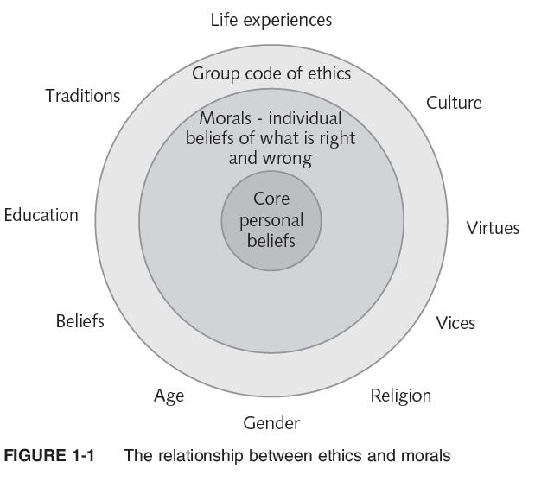

Slide 17
The Importance of Integrity
Integrity is a keystone of ethical behavior
People with integrity:
Act in accordance with a personal code of principles
Extend to all the same respect and consideration
Apply the same moral standards in all situations. Consistency can be difficult in a situation that conflicts with your moral standards.
For example, if your employer insists that, due to budget constraints, you do not report the overtime hours that you have worked, a moral conflict arises. You can do as your employer requests or you can insist on being fairly compensated, but you cannot do both. In this situation, you may be forced to compromise one of your principles and act with an apparent lack of integrity.
Lack of integrity emerges if you apply moral standards differently according to situation or people involved. For example: tell lie to spare pain of friend but can not lie in business losses

Slide 18
Many ethical dilemmas are not as simple as right versus wrong but involve choices between right versus right
As an example, for some people it is “right” to protect the Alaskan wildlife from being spoiled and also “right” to find new sources of oil to maintain U.S. oil reserves, but how do they balance these two concerns?

Slide 19
The Difference Between Morals, Ethics, and Laws
Morals: one’s personal beliefs about right and wrong
Ethics: standards or codes of behavior expected of an individual by a group
Law: system of rules that tells us what we can and cannot do
Sometimes the laws of these various jurisdictions are in conflict, creating confusion and uncertainty. In addition, laws are not static.
Legal acts are acts that conform to the law. Moral acts conform to what an individual believes to be the right thing to do. Laws can proclaim an act as legal, although many people may consider the act immoral—for example, abortion.
Laws may also proclaim an act as illegal, although many people may consider the act moral—for example, using marijuana to relieve stress and nausea for people undergoing chemotherapy treatment for cancer.

Slide 20
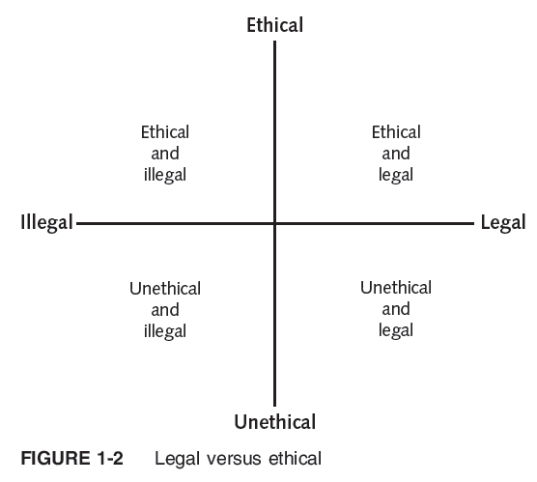
Laws raise important and complex issues concerning equality, fairness, and justice, but do not provide a complete guide to ethical behavior. Just because an activity is defined as legal does not mean that it is ethical (see Figure 1-2).
As a result, practitioners in many professions subscribe to a code of ethics that states the principles and core values that are essential to their work and, therefore, govern their behavior.
The code can become a reference point for helping an individual determine what is legal and what is ethical; however, an individual will also be guided by his or her set of morals.

Slide 21
C R I T I C A L T H I N K I N G E X E R C I S E : L E G A L V E R S U S E T H I C A L
Give an example of an action that fits in each of the four quadrants of the legal versus ethical chart shown in Figure 1-2—ethical and legal, ethical and illegal, unethical and illegal, and unethical and legal.

Slide 22
Ethics in the Business World
Both the likelihood and the negative impact of inappropriate behavior have increased
Several trends have increased the likelihood of unethical behavior:
Globalization creates complex work environments (e.g., china offers cheap labour work for iPhone)
Organizations challenged to maintain profits/revenue and hence apply unethical practices, e.g., Tesco, Britain’s largest supermarket chain, admitted its first half-year of profits for 2013 were overstated by $400 million. Fiat Chrysler Automobiles admitted its U.S. auto sales were overstated by hundreds of cars each month starting as far back as 2011.
Heightened vigilance by:
Employees
Shareholders
Regulatory agencies

Slide 23
Ethics in the Business World (cont’d.)
Recent scandals in IT companies
GG Volkswagen has admitted that 11 million of its vehicles were equipped with software that was used to cheat on emissions tests. The company is now contending with the fallout.
Toshiba, the Japanese industrial giant whose diversified products and services include information technology and communications equipment and systems, disclosed that it overstated its earnings over a seven-year period by more than $1.2 billion.
Amazon has the second highest employee turnover rate of companies in the Fortune 500 and has been criticized by some for creating a high pressure work environment in which bosses’ expectations were almost impossible to satisfy and jobs were threatened if illness or other personal issues encroached on work.

Slide 24
Not just executives, but even lower-level employees, can find themselves in the middle of an ethical dilemma
Edward Snowden, working as a Dell contractor at the National Security Agency (NSA), copied thousands of classified and unclassified documents that revealed details about the capabilities and scope of operations of the NSA and other foreign intelligence agencies. The documents were then handed over to reporters who published many of the disclosures in the Guardian and Washington Post newspapers. Snowden felt he acted as a patriot in exposing the behavior of the NSA, which he thought was overreaching and counter to the U.S. Constitution. Some consider him a whistle-blower and a hero, while others see him as a traitor.

Slide 25
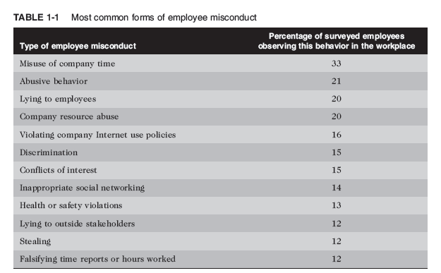
Table 1-1 identifies the most commonly observed types of misconduct in the workplace.

Slide 26
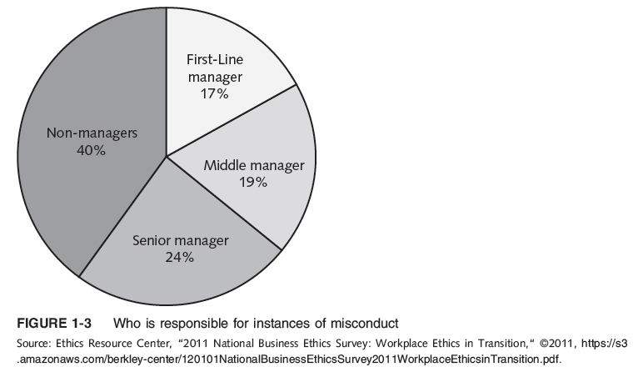
According to the 2013 National Business Ethics Survey, it is managers—those expected to act as role models and enforce discipline—who are responsible for 60 percent of workplace misconduct, as shown in Figure 1-3.

Slide 27
C R I T I C A L T H I N K I N G E X E R C I S E : C U T T E S T I N G S H O R T
You are a new hire at a large software firm and have been working overtime for the last two months trying to complete the final testing of a new software release for the firm’s flagship product, which is used by thousands of organizations worldwide. Unfortunately, the software has many bugs and testing has taken weeks longer than expected. This afternoon your boss stopped by and asked you to “sign off” on the completion of your portion of the testing. He explains that the project has gone over budget and is in danger of missing the committed release date for customers. When you object because you feel the software is still buggy, he says not to worry, whatever bugs remain will be fixed in the next release of the software. What do you do?

Slide 28
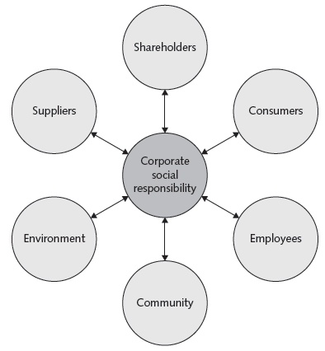
C O R P O R A T E S O C I A L R E S P O N S I B I L I T Y
Corporate social responsibility (CSR) is the concept that an organization should act ethically by taking responsibility for the impact of its actions on its shareholders, consumers, employees, community, environment, and suppliers (see Figure 1-4).
An organization’s approach to CSR can encompass a wide variety of tactics i.e., donating a portion of net profit to charity, to implementing more sustainable business operations, or encouraging employee education through tuition reimbursement.
Setting CSR goals encourages an organization to achieve higher moral and ethical standards.
FIGURE 1-4 An organization’s program CSR affects its shareholders, consumers, employees, community, environment, and suppliers.

Slide 29
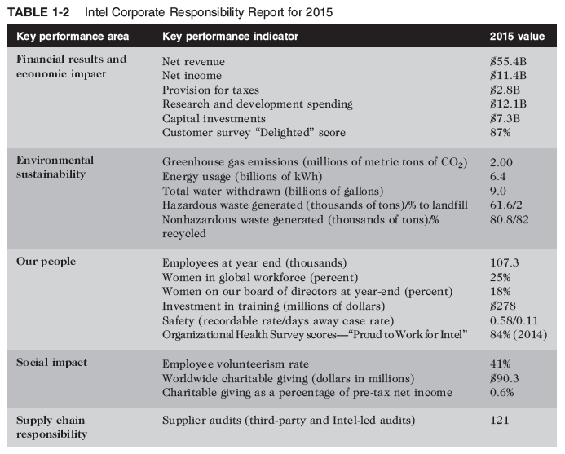
Table 1-2 shows a summary of the 2015 corporate responsibility report for Intel.

